Slide 1
Rooftop Windmill
Zach Bischoff
Devin Goldstein
Benneth Rejuso
Logan Wharton
Notes:
Logan

Slide 2
motivation
Demand for clean energy
01
Alternative to solar in residential areas
02
Expansion of small wind turbine applications
03
Energy source in low photo-voltaic areas
04
Weather information
05
Notes:
Devin

Slide 3
Goals and objectives
Reasonably sized wind turbine package
01
Portable design
02
Power efficient (generate more power than it uses)
03
Minimal cost
04
Display sensor information
05
System runs when turbine is not generating power
06
Cooling Systems
07
Notes:
Zach

Slide 4
High Level design
Wind Turbine
Battery
Sensors
MCU
Information Display
Notes:
Benneth

Slide 5
Division of responsibility
 | Zach | Devin | Ben | Logan
Wind Turbine |  |  | 2 | 1
Battery |  |  | 1 | 2
Sensors | 1 | 2
MCU | 2 | 1
PCB |  |  | 1 | 2
Information Display | 2 | 1
1 : Primary
2: Secondary
Notes:
???

Slide 6

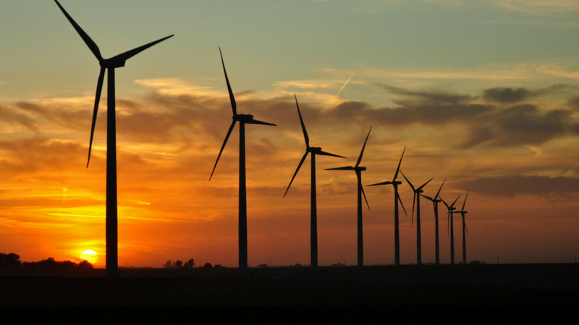
Wind turbine
logan

Slide 7
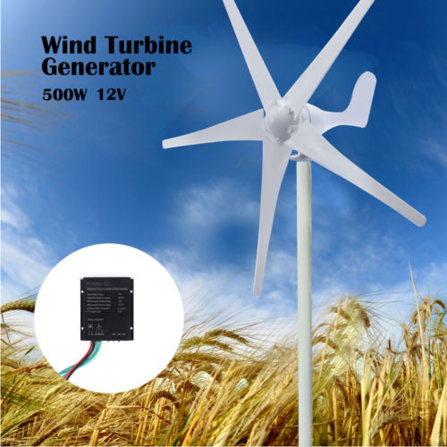
Wind turbine: Specifications
Power Output = 500 W
Weight = 6.8 Kg
Height = 4m
Start-up wind speed = 2 m/s
Survival wind speed = 50 m/s
Rated wind speed = 13 m/s

Slide 8
Wind turbine: Output (possible uses)
Residential/Industrial power generation
Portable power
Weather monitor

Slide 9

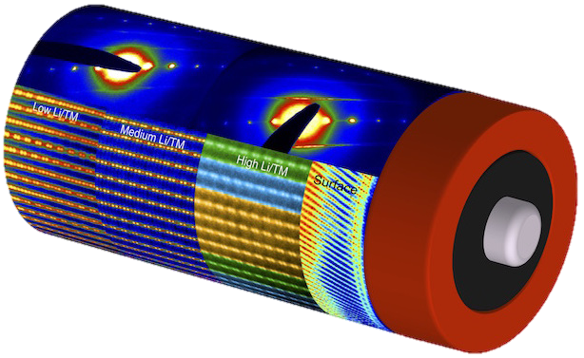
Power
Benneth

Slide 10

Power flow
Wind Turbine
Charge Controller (24V to 12V)
Battery
Voltage Regulators (12V to 5V) (5V to 3V)
MCU and Sensors
Notes:
General flow of the power
Wind turbine generates power a charge controller ensures that 12 V goes into the battery
Voltage regulators step down the voltage to necessary levels for the MCU and sensors

Slide 11
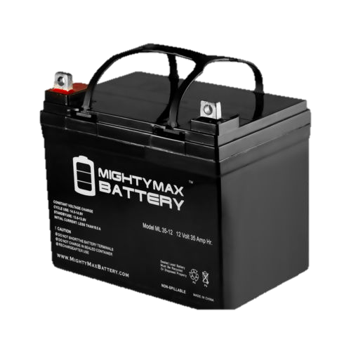
Battery
Chemistry: SLA, AGM
Technology: Deep Cycle
Cost: > $70
Voltage: 12 V
Battery Capacity: 35 Ah
Weight: 23.15 lbs.
Notes:
Sealed Lead Acid, Absorbed Glass Mat
SLA batteries have been around for decades. Because of this, they are cheap and very reliable.
We want a deep cycle battery because we need the ability to exhaust a percentage of it’s capacity on a regular basis
Some downsides we have to work around are the size and weight

Slide 12
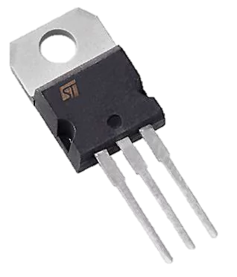
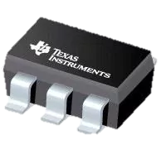
Voltage regulator
Manufacturer: STMicroelectronics
Part Number: L7805CV
Output Voltage: 5 Volts
Output Current: 1 Amp
Manufacturer: Texas Instruments
Part Number: TPS780330200DDCR
Output Voltage: 2, 3.3 Volts
Output Current: 150 mAmp
Notes:
Two voltage regulators

Slide 13
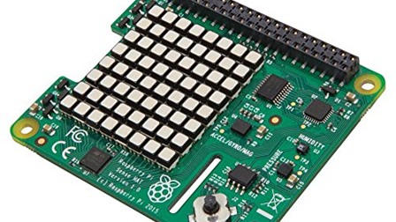
Sensors
Zach

Slide 14
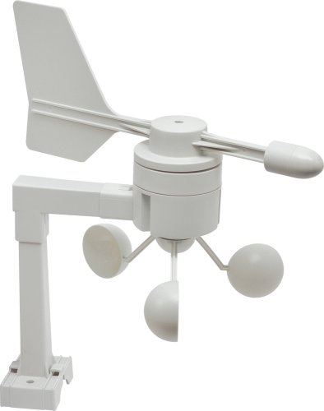
Sensors: What we want to measure
Wind Speed
Wind Direction
Internal Temperature
External Temperature
Energy Generated
Energy Consumption

Slide 15
Sensors: what sensors we will use
2 Current Sensors Adafruit IA219
I2C Pins
1 Magnetometer Adafruit LSM9DS1
I2C Pins
1 Analog to Digital Converter Adafruit ADS1015 12bit
I2C Pins
2 Thermistors Gikfun EK9033
Read via the ADC
Notes:
Power curve is used to find the wind speed using the measured current

Slide 16
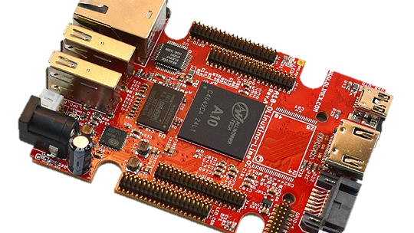
MCU
Devin

Slide 17
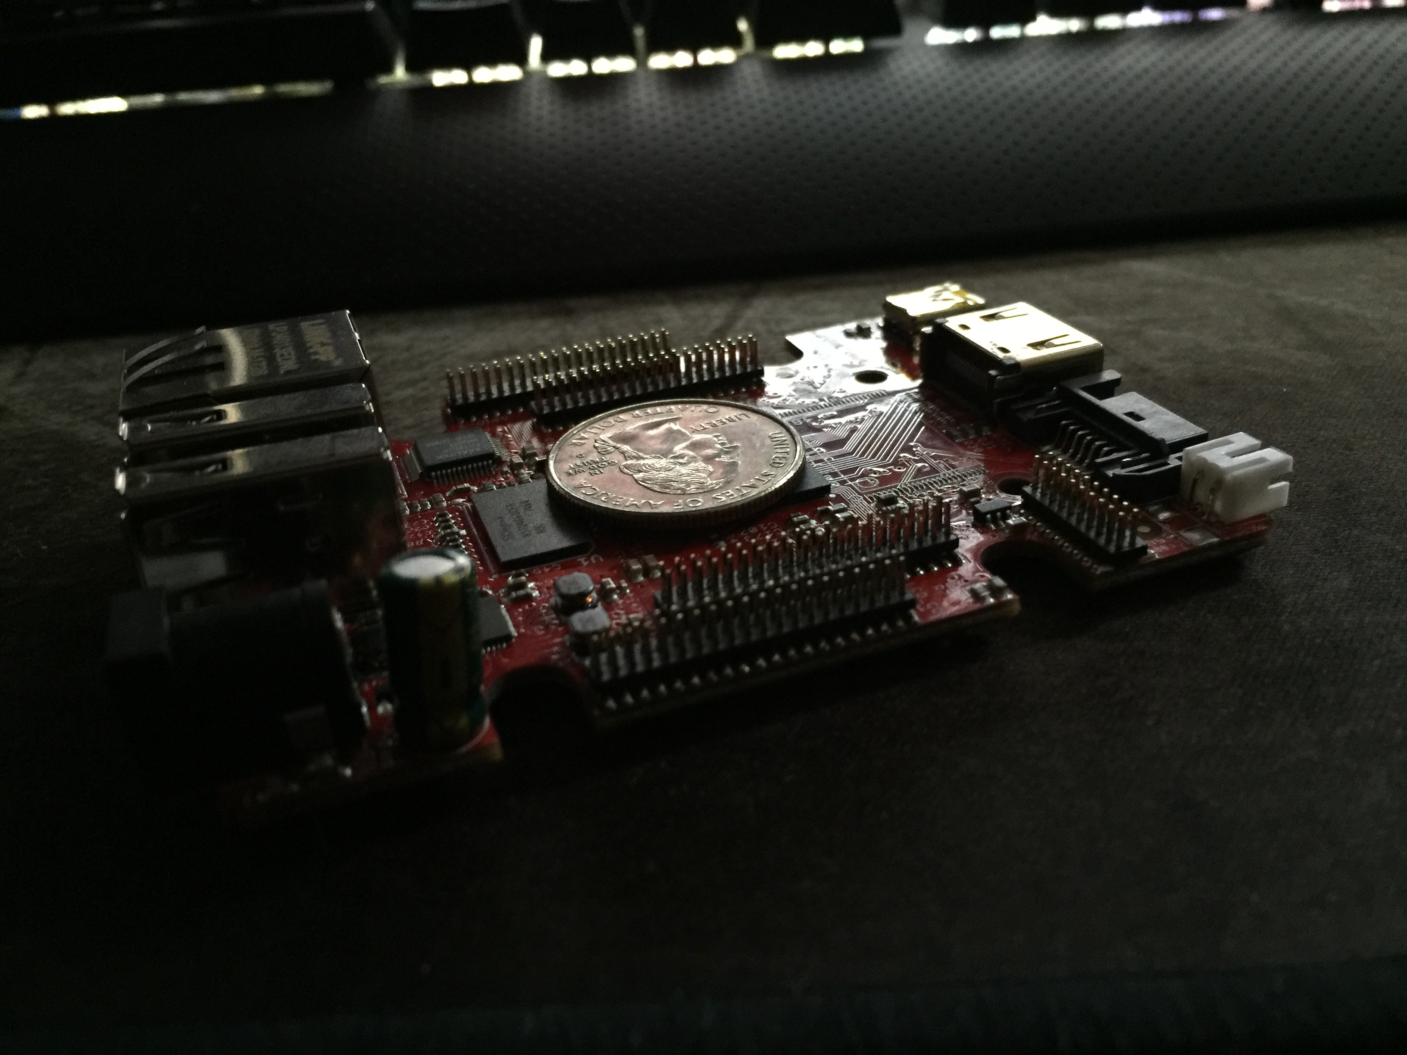
Microcontroller Specifications
A10-OLinuXino-LIME
It can run Android or a Linux operating system. We will be going with Linux.
The main Linux distros supported by the A10-LIME:
Debian
Ubuntu
OpenSUSE
Peripheral Support
3 I2C buses
3 SPI buses
UART
HDMI, Ethernet, USB, LCD Connector, SATA, MicroSD

Slide 18
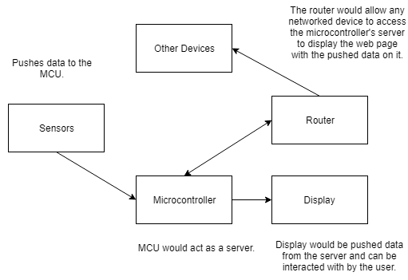
Why this Microcontroller?
Which Operating System did we choose?.
OpenSUSE
Why?
It has the latest version of Python available to it within its package manager thus allowing us to use Django with Python 3.
HDMI and USB allow us to connect an external display with touch to allow users to navigate the web page.
Ethernet allows us to connect the MCU to the network to have the page available to any device that is on the network, including the internet.

Slide 19
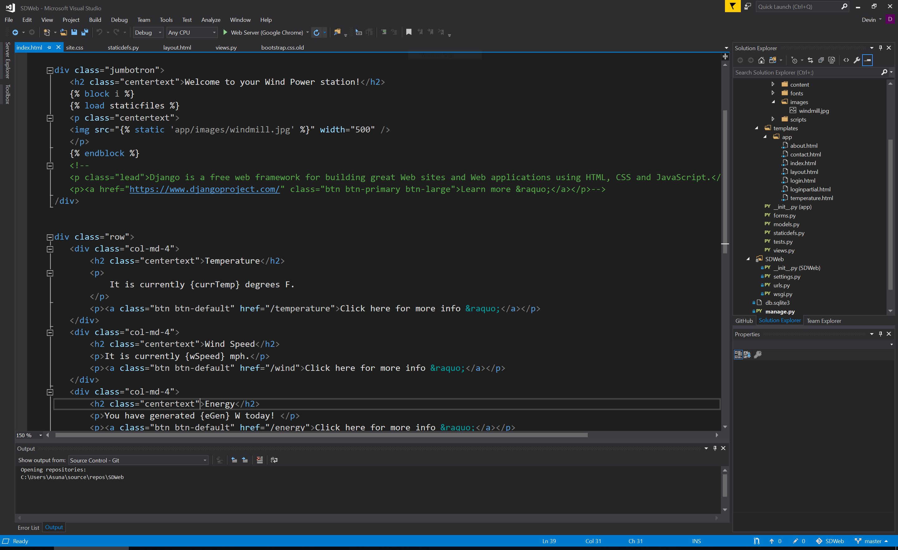
Programming language and why
The A10-LIME's GPIO library is written in Python, therefore Python became our go to language for this project.
Python is an object oriented language.
This will allow us to speed up software development because we don’t have to write boilerplate code just to start the project. The library will do this for us.
The web server will also be written in Python, the Django framework specifically.
The pages themselves will be written in a combination of HTML, CSS, and JavaScript.
Python is cross-compatible, so we can debug on a higher-end machine/operating system and optimize the system later. Therefore we can write in an IDE like Visual Studio and transfer it later.
Git will be used for source control for easy version tracking and synchronizing between our group members.

Slide 20

pcb
benneth

Slide 21
High level overview
Battery
12 V
Regulator
5 V
Regulator
~3.3V
Sensors
MCU
Display

Slide 22
Power regulation
Notes:
Here is the power regulation circuit
We followed the suggested application circuits for each regulator
As of now we have it set up to step down from 12 V to 5 V, then 5 V to 3.3 V

Slide 23
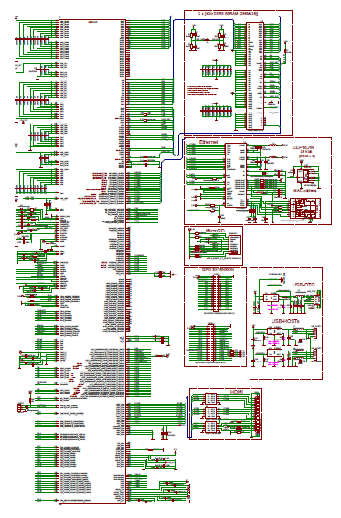
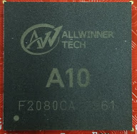
MCU Implementation
1.2 GHz ARM Cortex A8 with Mali-400 GPU
Package Type: Ball Grid Array (BGA)
Dimension: 18mm x 18mm (0.4" x 0.4")
Notes:
Currently still working on this design
Had problems with OrCAD and had to switch to Eagle
About 400 pins on the chip
Open source under GPL – able to find an existing schematic symbol for the chip because of this

Slide 24
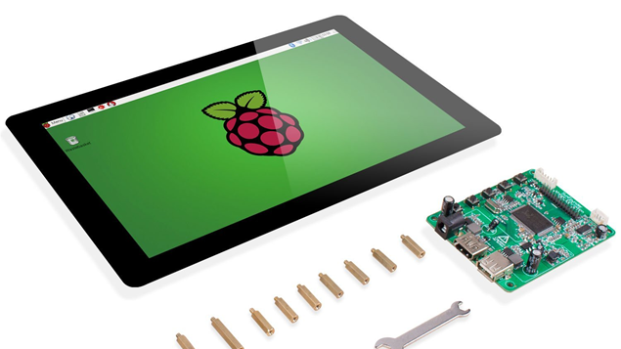
Information display
zach

Slide 25
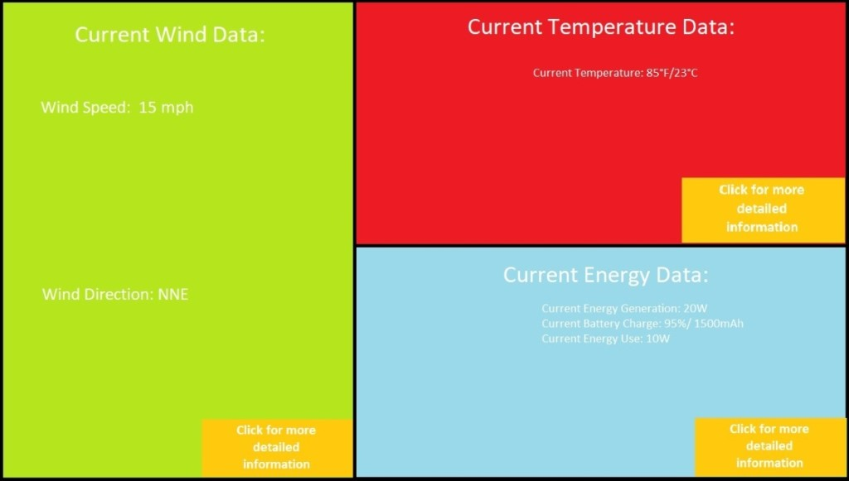
info display: what data to display
Wind Speed
Wind Direction
Current being produced
Current being consumed
Power being produced
Power being consumed
Voltage being consumed
Preliminary Web Page Design

Slide 26
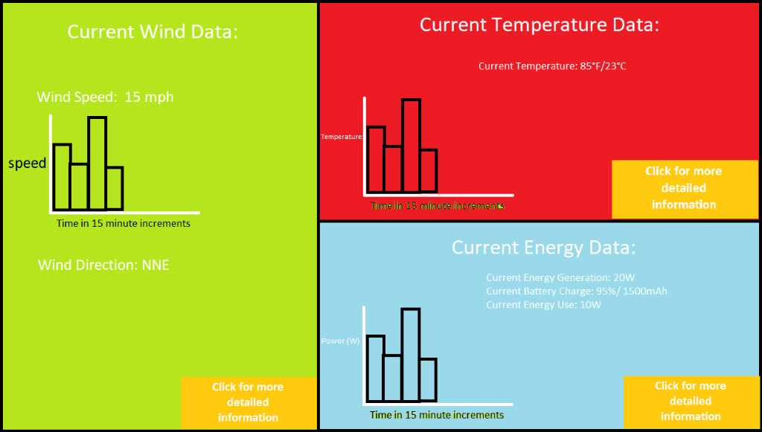
info display: how to display
Display the data on a webpage
Webpage run via server running on the MCU
Gather new data every 5 minutes
Utilize python libraries to interface with the sensors
Use this information, along with some basic calculations to determine data
Pass that information to the server so that it can be displayed on the webpage
Have webpage opened on an touch enabled LCD Display
Allows for user interaction with webpage
Preliminary Web Page Design

Slide 27

Project: by the numbers
devin

Slide 28
Project: budget
Notes:
Est budget -> total budget -> Priority -> who’s buying -> bought status -> organization

Slide 29
Project: completion
Notes:
Research – What we don’t know.
Design – Mostly PCB
Material – Wood and Cables/Low priority
Prototyping – We only have started with the web page
Testing – Web page and voltage regulation circuits

Slide 30
Project: pictures
Devin and zach

Slide 31
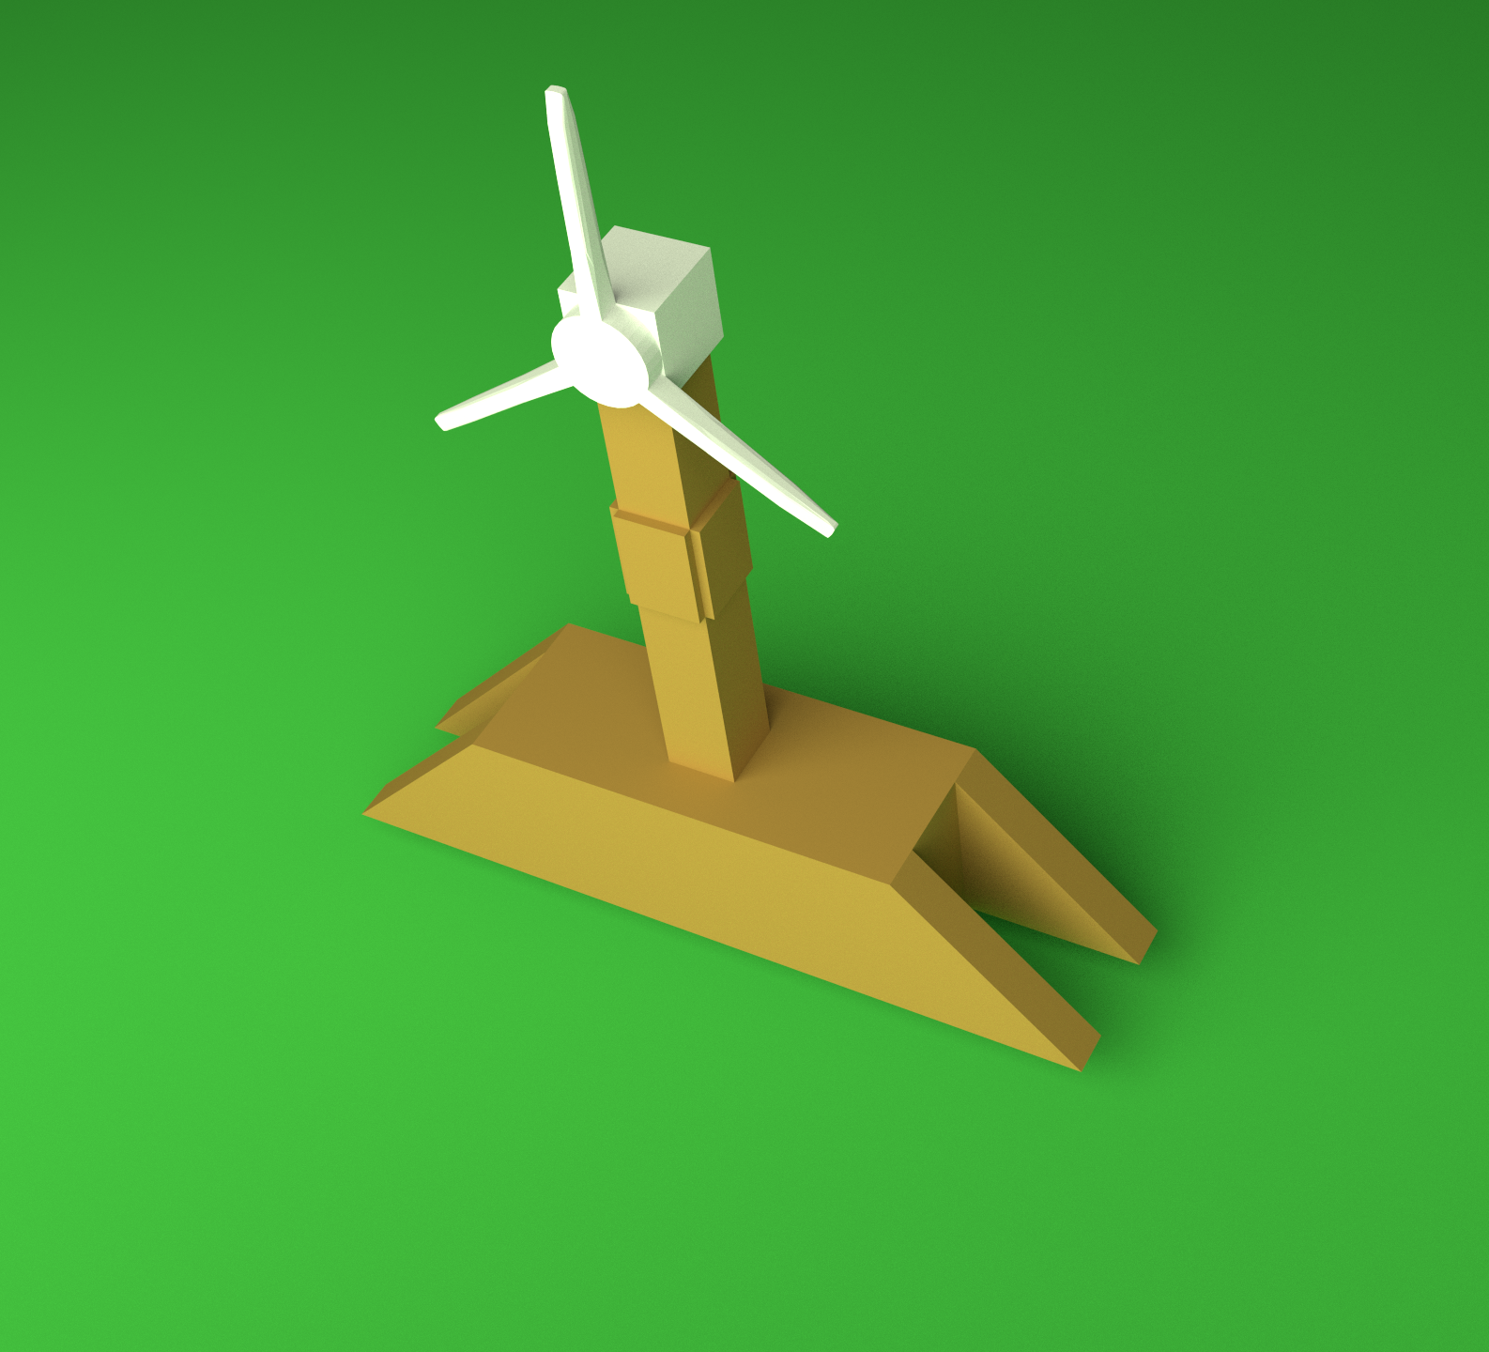
Project: enclosure design

Slide 32
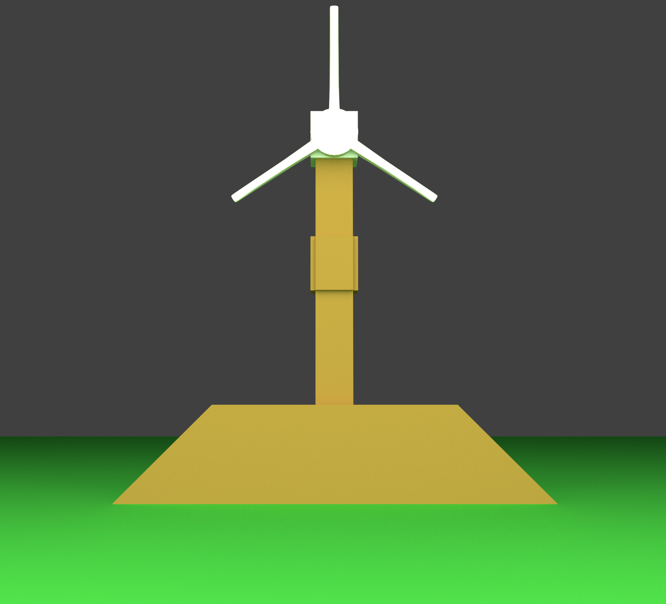
Project: enclosure design

Slide 33
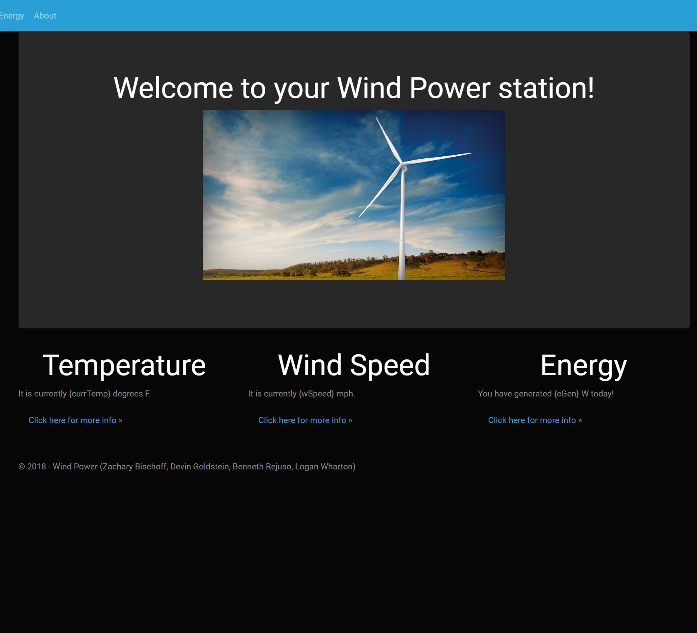
Project: web page design

Slide 34
Questions?

